Slide 1

Trees

Slide 2
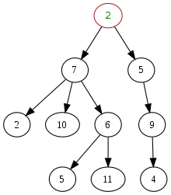
Trees in Computer Science are Upside Down
Notes:
https://en.wikipedia.org/wiki/Tree_(data_structure)#/media/File:Tree_(computer_science).svg

Slide 3

Tree
Trees are container where elements are stored in nodes
Each node has pointers to its child nodes
The “top” of the tree (aka the root) has no parent
No cycles are allowed: no node can be its own ancestor

Slide 4
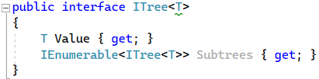
Tree ADT Interface

Slide 5
Additional Terms
Root
the top-most element of a tree. A node with no parent.
Every non-empty tree has one. Only one exists.
Leaf
a bottom-most element of a tree. Has no children.
Every non-empty tree has at least one.
Height
the distance from the root to the furthest leaf, counting the nodes.
Siblings
two or more nodes that share the same parent
Forest
a set of trees (e.g., a structure with multiple roots)

Slide 6

What if I have multiple roots?
A data structure like a tree with multiple roots is called a forest.
You can convert a forest to a tree by create a new root

Slide 7
Trees are Everywhere
XML / HTML
Mathematical expressions
Language parsing
JSON objects
Nested lists
Space partitioning
Hierarchical Level of Detail (LOD)
Sorting
Binary numbers

Slide 8

Properties of Trees
Ordered or unordered
Balanced or unbalanced
Fixed or variable dimensional

Slide 9
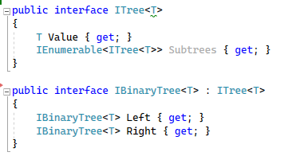
Binary Trees
A tree where every node has zero, one, or two children is called a binary tree.

Slide 10
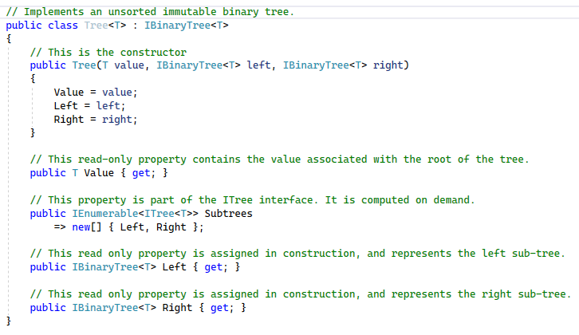
Binary Tree Implementation

Slide 11
Search and Traversal Operations
Is an element present?
Where is the element in the collection?
Find an element that satisfies a criteria?
With each element that satisfies a criteria do something?
Find first/last N elements that satisfy a criteria?

Slide 12
Tree Traversal
Also known as walking a tree, or visiting a tree.
Two main categories
Breadth first search (BFS) aka Level-order
Depth first search (DFS) includes: pre-order, in-order, post-order

Slide 13

Three Types of Depth First Search
In-order - child A, self, child B
Pre-order – self, child A, child B
Post-order – child A, child B, self

Slide 14
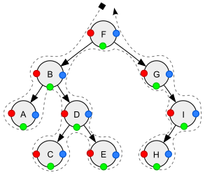
Depth First Tree Traversal
Red = pre-order
Green = in-order
Blue = post-order

Slide 15

Breadth First Search using a Queue
Enqueue root node
While Queue is not empty
Dequeue a node
Enqueue its children
Visit the node

Slide 16

Depth First Search using a Stack
Push root node
While Stack is not empty
Pop a node
Push its children
Visit the node

Slide 17

Interview Question Alert
Very common interview question:
Implement breadth first search and depth first search
Let’s try them both

Slide 18
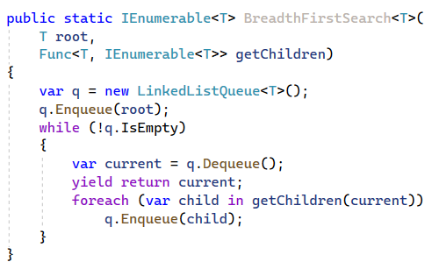
Breadth First Search – Uses a Queue

Slide 19
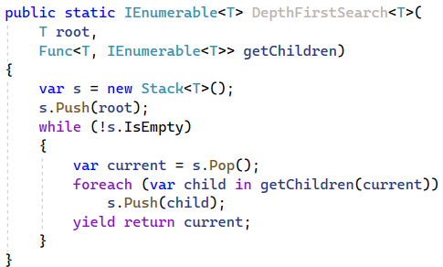
Depth First Search – Uses a Stack

Slide 20
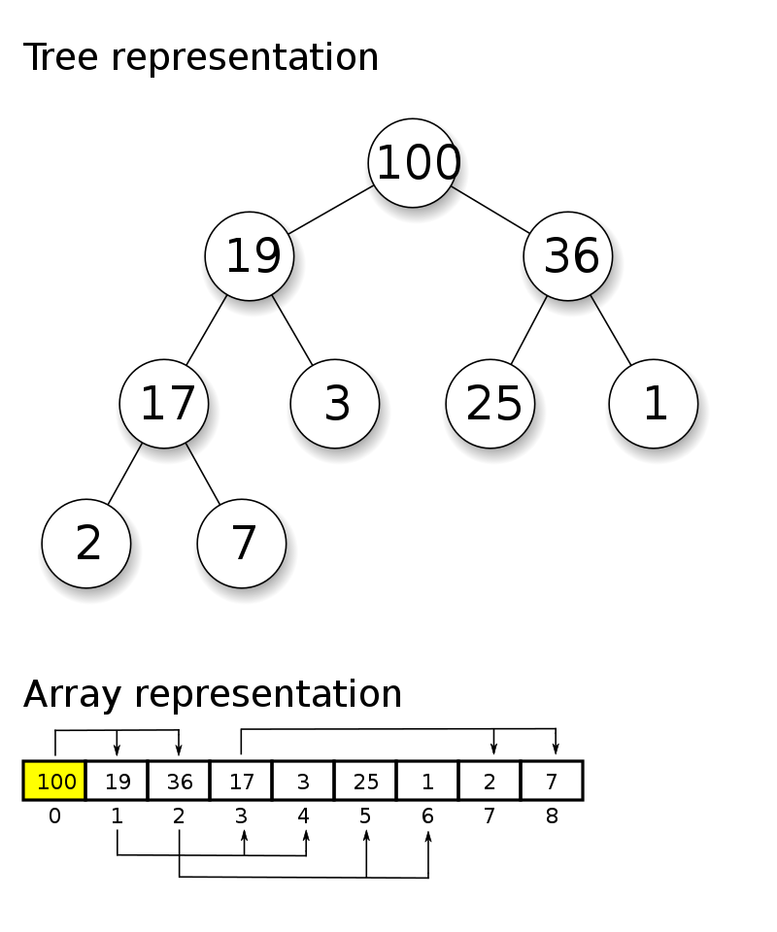
Heaps
A heap is a binary tree with the property that every root element is greater than the children

Slide 21

Priority Queue
A heap can be used as a priority queue
Each element needs to be paired with a priority

Slide 22
Binary Search Trees (BST)
Binary trees that are order preserving are called binary search trees.
1
They have excellent performance when trees are balanced.
3
Nodes in left tree greater than values in right tree
2

Slide 23
Inserting into BST
Have to create a new tree
Compare value to node
If less than insert into left child
Else insert into right child

Slide 24

Exercise
Implement an insertion algorithm for the binary search tree.

Slide 25
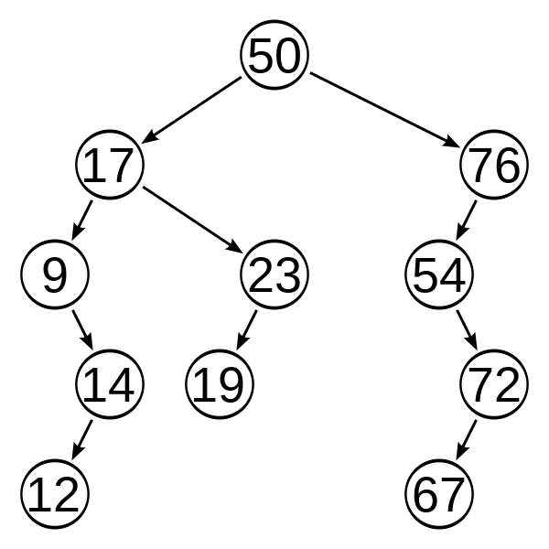
What does an unbalanced tree look like?

Slide 26

Balanced Trees
A balanced tree has height that is on the order of Log2(N)

Slide 27
Balanced Tree Definition
The definition of balanced is implementation-dependent.
In red black trees, the depth of any leaf node is no more than twice the depth of any other leaf node.
In AVL tree, the height of the left and right children never differ more than one.

Slide 28
Restoring Balance
After every insertion
If tree becomes unbalanced
Restore balance via rotation

Slide 29
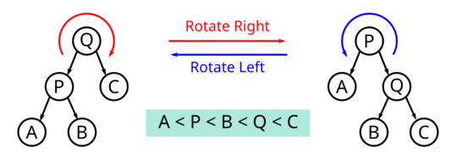
Tree Rotations
Notes:
https://en.wikipedia.org/wiki/Tree_rotation

Slide 30
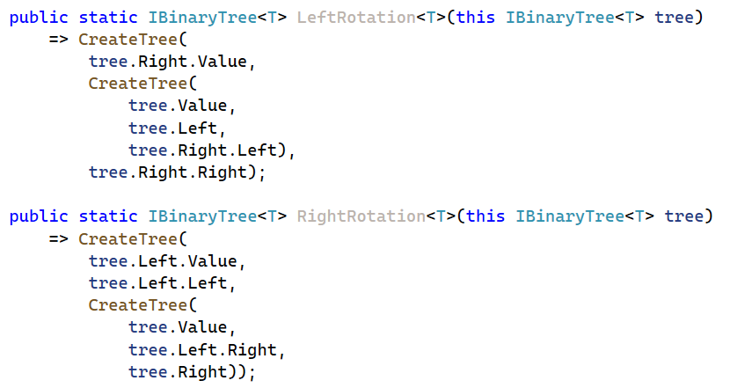
Left and Right Rotations in Code
Exercises: are these operations order preserving? What is the complexity? Test and prove your hypothesis.

